Slide 1


PREDICTIVE MODELING OF
EMPLOYEE ATTRITION
A Machine Learning Approach to Strategic Workforce Retention: Transforming HR Management from Reactive Reporting to Proactive Intelligence
Presented by: Khushboo Hattar (22CSE16) | Kanchan Kumari (22CSE20) | Muhammad Siraj (22CSE18), Syed Yaqoob Naqvi (22CSE47)
Final Year Project | Data Science & Analytics
CLASS IMBALANCE | ENSEMBLE LEARNING | FEATURE ENGINEERING | ROC-AUC

Slide 2

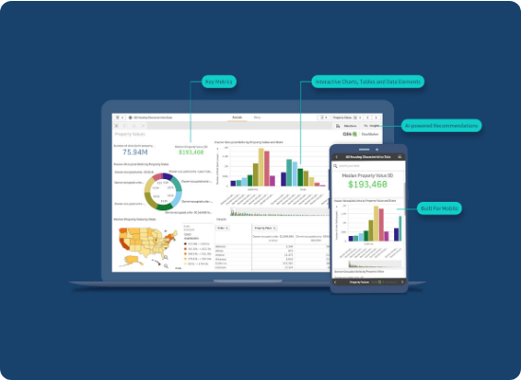
PROJECT INTRODUCTION
Employee Attrition: The voluntary reduction of a workforce over time, posing significant risks.
Human Capital: Recognized as the most critical competitive asset in the modern global economy.
Foundation: Utilizing the comprehensive IBM HR Analytics Dataset.
Objective: Identifying complex behavior patterns to forecast turnover before it happens.

Slide 3






PROBLEM STATEMENT
Knowledge Gap
Economic Impact
Technical Challenge
Traditional HR KPIs are lagging indicators—they only tell us who already left, providing no path for intervention.
Direct costs of hiring/onboarding combined with indirect costs like productivity loss and morale decline impact the bottom line.
Modeling non-linear relationships across 35+ diverse features (Income, Distance, Overtime) requires advanced ML architectures.

Slide 4






PROJECT MOTIVATION
Business Intelligence
Data-Driven HR
Strategic Growth
Substantially reduce the "Cost-per-Hire" by focusing on high-value employee retention strategies.
Moving beyond intuition-based decisions to actionable, machine-learned insights for management.
Protecting organizational knowledge and ensuring long-term talent continuity and stability.

Slide 5
DATASET OVERVIEW
Source: IBM HR Analytics Employee Attrition Dataset
Property | Details | Significance
Total Records | 1,470 Observations | Sufficient sample for statistical significance
Total Features | 35 Variables | Multidimensional employee profiles
Target Variable | Attrition (Yes / No) | Binary classification objective
Data Categories | Numerical, Categorical, Ordinal | Requires mixed preprocessing techniques

Slide 6
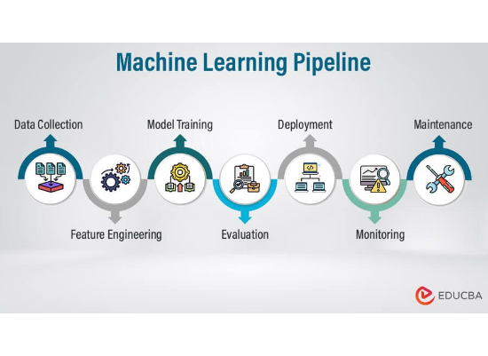
PROPOSED ML PIPELINE
Data Collection: Ingestion of IBM CSV raw data.
Data Cleaning: Outlier detection and noise removal.
Feature Engineering: Transforming variables for model intake.
Model Training: Applying Ensemble methods (RF, XGB).
Insights: Strategic reporting for HR stakeholders.

Slide 7
DATA PREPROCESSING
Handling Class Imbalance: Since the majority of employees stay, we implemented resampling strategies (SMOTE) to prevent model bias towards the majority class.
Feature Pruning: Removed irrelevant constants such as EmployeeNumber, Over18, and StandardHours which add zero predictive variance.
Normalization: Handled missing values and addressed outliers in compensation data to stabilize gradient descent during training.

Slide 8

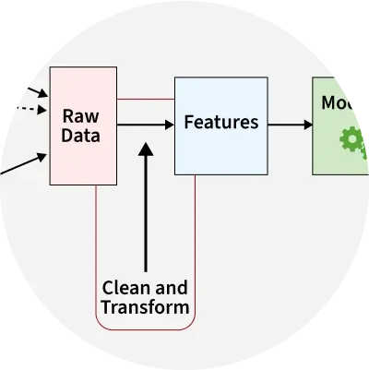
FEATURE ENGINEERING
Label Encoding: Applied to ordinal variables like Education and Job Satisfaction level.
One-Hot Encoding: Used for nominal variables like Department and Job Role to avoid false ordinal ranking.
Selection: Utilized correlation analysis to reduce noise and multicollinearity.
Result: Significantly improved model generalization and decreased training time.

Slide 9







MODELING STRATEGY
Random Forest
XGBoost
Ensemble Logic
Used for its robust handling of complex feature interactions and resistance to overfitting through bagging and feature randomness.
Extreme Gradient Boosting provided the highest accuracy by iteratively correcting residuals and using specialized regularization.
We prioritized non-linear models as employee behavior is rarely a linear function of a single variable like "Salary".

Slide 10



TECH STACK
Python Core
Scikit-Learn
Visualization
Pandas for manipulation, NumPy for numerical computation, and Anaconda as the environment.
The primary library for the ML pipeline, cross-validation, and performance evaluation metrics.
Seaborn and Matplotlib for generating correlation heatmaps and feature importance plots.

Slide 11
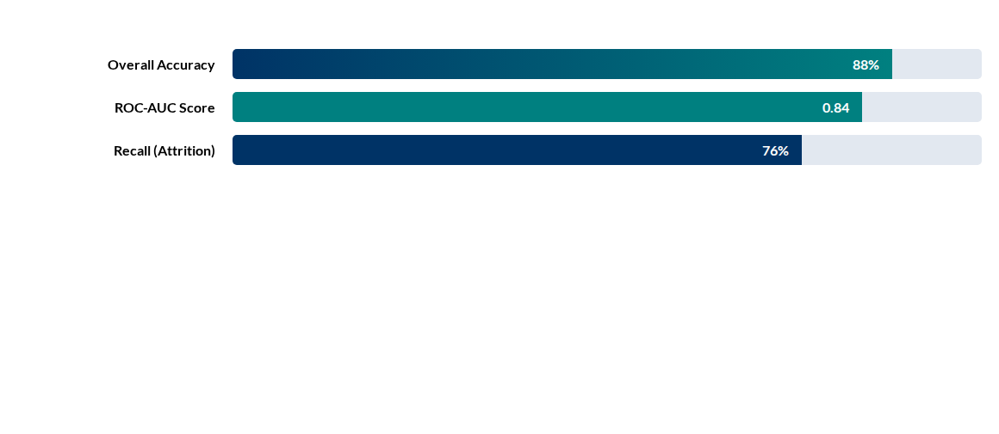

MODEL PERFORMANCE
Accuracy Formulation:
Focus: Minimizing False Negatives (Employees predicted to stay who actually leave).

Slide 12
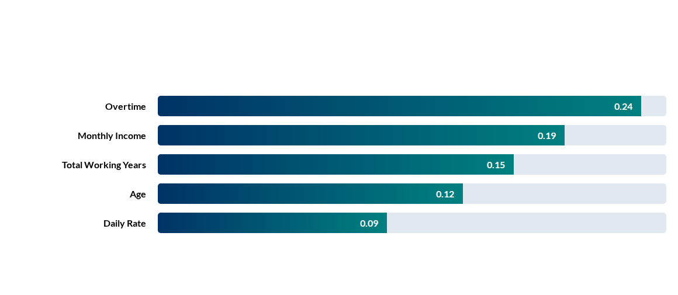
KEY PREDICTORS
Feature Importance Ranking (Gini Importance):

Slide 13
HR BUSINESS INSIGHTS
High Risk: Low JobLevel, Monthly Income, and Tenure are primary indicators.
Demographics: Single and Male employees show a higher statistical likelihood of quitting.
Travel Impact: Frequent Business Travel significantly increases attrition probability.
Burnout: High Overtime is the strongest single correlation with immediate resignations.
R&D Strength: The Research & Development department shows the highest retention rates.
Stock Options: Strategic stock option levels inversely correlate with attrition.

Slide 14
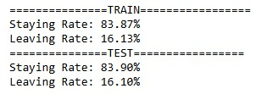
CORRELATION
ANALYSIS
Monthly Income ↔ Job Level: Strong positive correlation as expected.
Age ↔ Working Years: High linear dependency.
Marital Status ↔ Stock: Significant negative correlation for single status.
Visualization helps identify multicollinearity for feature selection.

Slide 15
IMPACT & SCALABILITY
20%
Early
100%
Churn Reduction
Identification
Data-Driven
The model enables proactive HR interventions, allowing companies to engage at-risk talent before the resignation is filed.

Slide 16


Conclusion
Our ML framework successfully transitions HR from reactive to proactive, proving that employee behavior can be mapped and predicted with over 88% accuracy.
Future Work
Live HRMS
Integration of Deep Learning (ANNs) for higher accuracy and real-time dashboard deployment via web interfaces.
Connecting the pipeline directly to real-world HRMS systems for automated attrition alerts and sentiment analysis.
Questions?

